Slide 1

Super-Resolution for Satellite Imagery

Slide 2
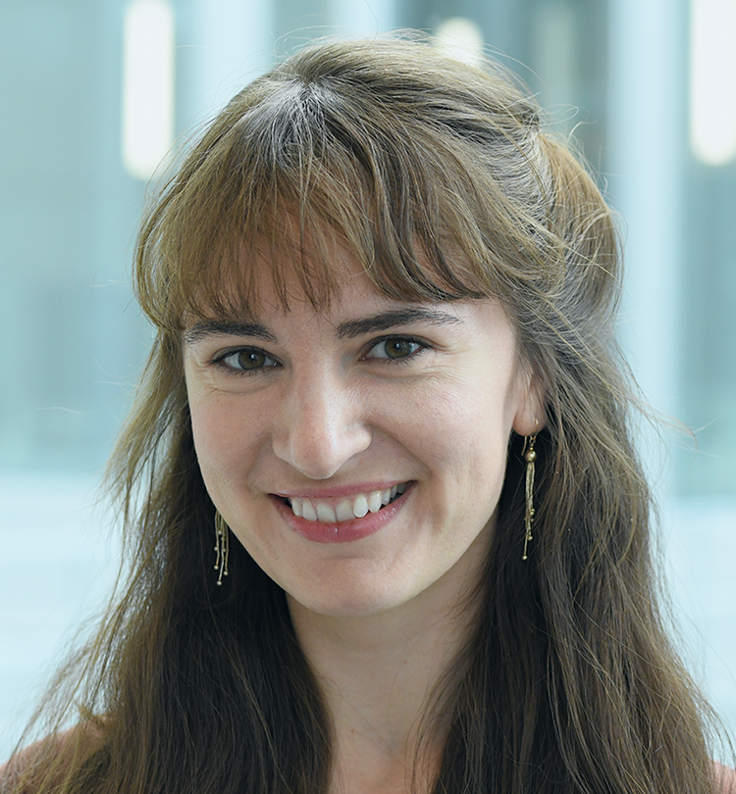
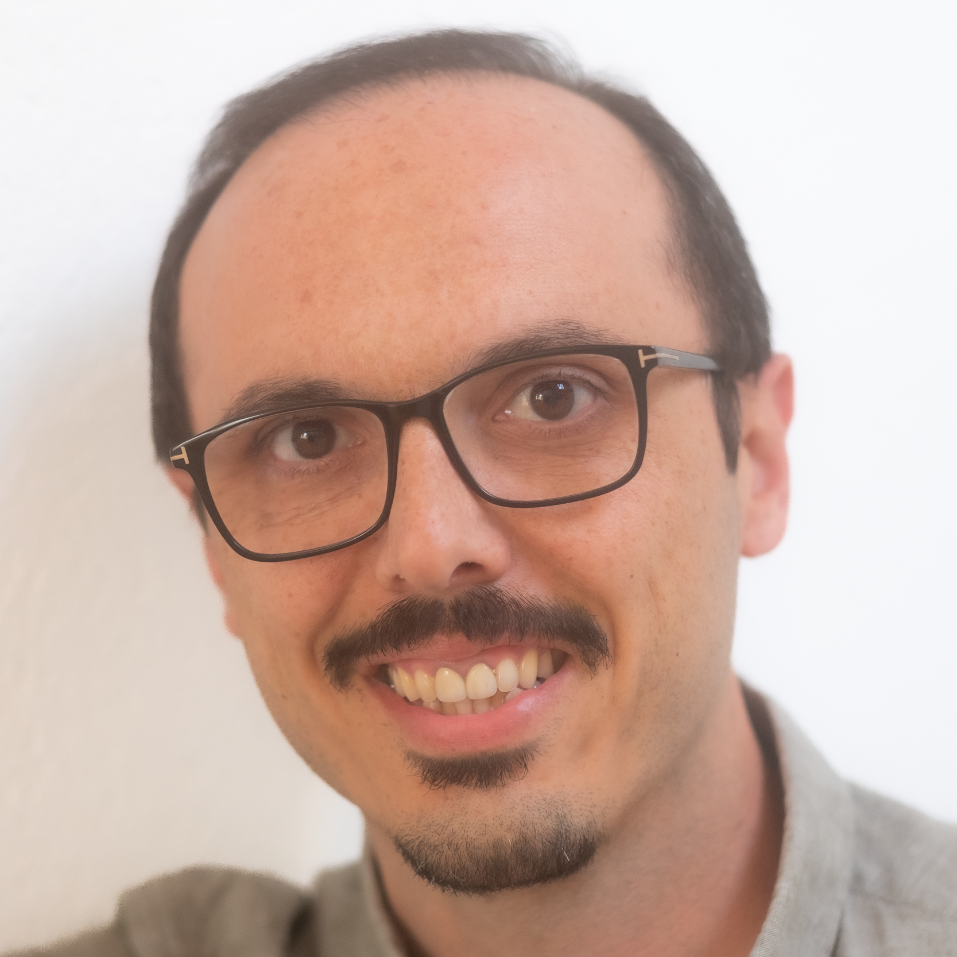
Our background
Elena
Gronskaya
Özgün
Haznedar
MSc, Biochemistry
University of Oxford
PhD, Neuroscience
ETH Zürich
15+ years in experience in Banking / Treasury
Development Economics Financial Engineering

Slide 3
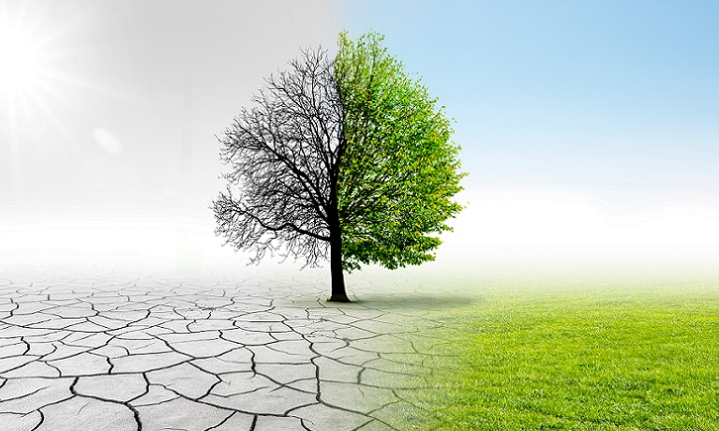
Consulting for companies, governments and organizations to implement carbon emission reduction strategies as well as climate action and sustainability projects
intervention
The objective
to assess the impact of climate action interventions (reforestation, sustainable farming practices, etc.)
The method
compare satellite images in a given area before and after an intervention (7-10 year time span)
7-10 years
deforestation
reduced carbon sequestration
impact?

Slide 4
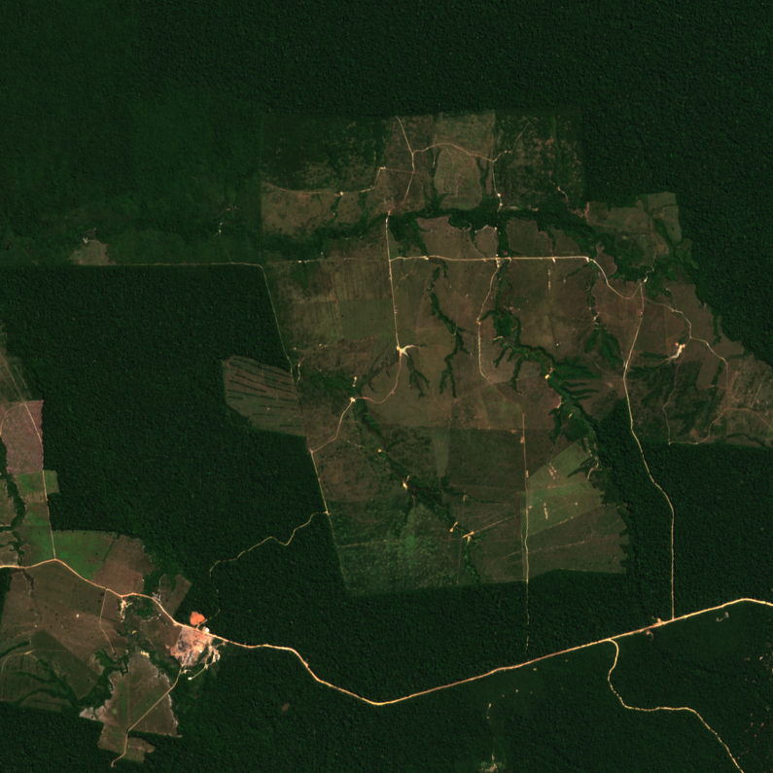
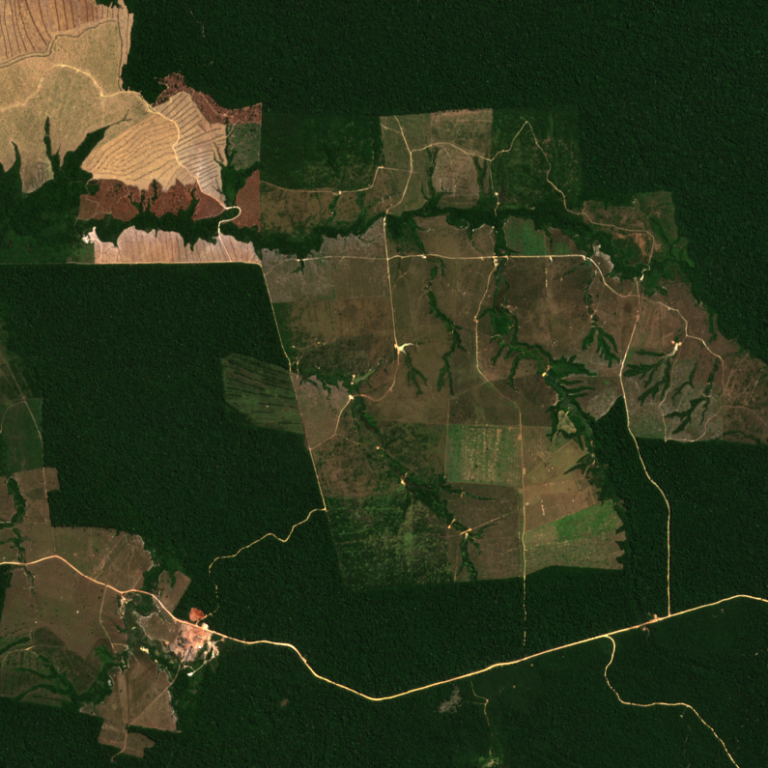
2020-07
2021-08

Slide 5
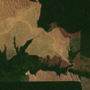
The Business Problem
The resolution of older images is insufficient for meeting accuracy requirements for pre-post intervention comparisons
High Resolution
(Sentinel-2, available from 2017)
Low Resolution
(Landsat-8)
Super Resolution?

Slide 6
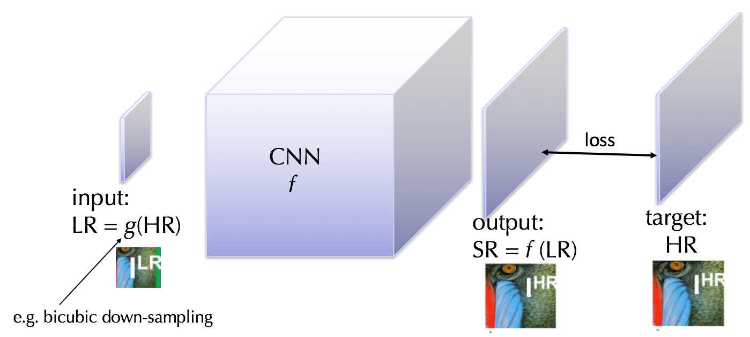
Super-Resolution via Deep Learning
2021-08
https://medium.com/idealo-tech-blog/a-deep-learning-based-magnifying-glass-dae1f565c359

Slide 7
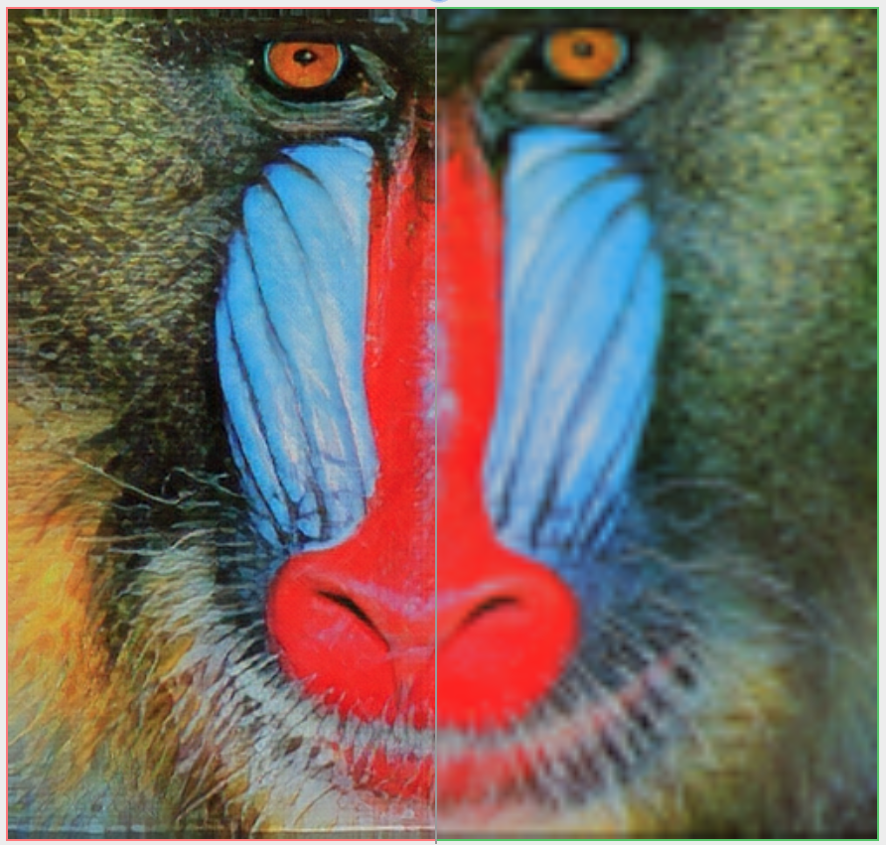
Super-Resolution via Deep Learning
2021-08
https://medium.com/idealo-tech-blog/a-deep-learning-based-magnifying-glass-dae1f565c359

Slide 8
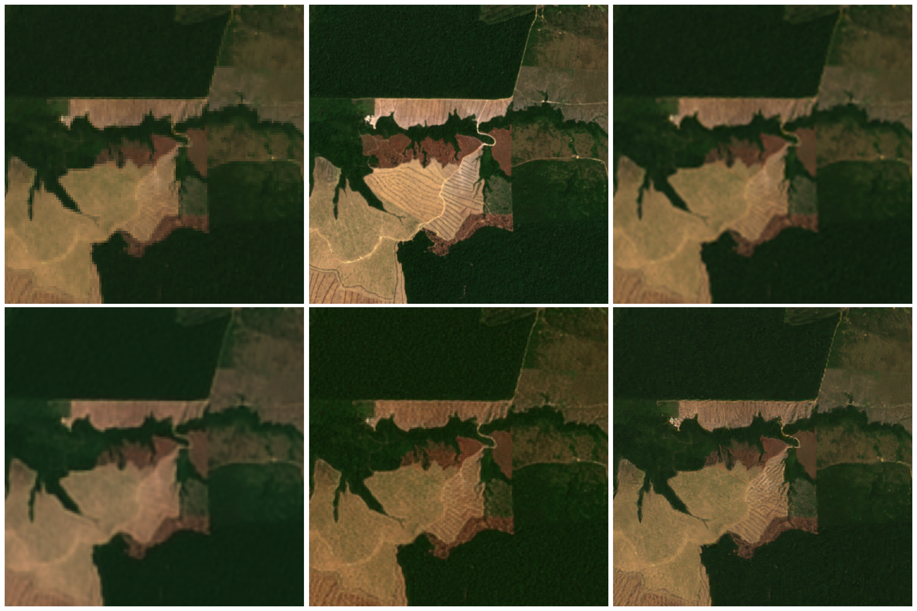
landsat sentinel
RDN RRDN EDSR-SARGAN

Slide 9
landsat sentinel bicubic
RDN RRDN EDSR-SARGAN

Slide 10
landsat sentinel bicubic
landsat sentinel bicubic
RDN RRDN EDSR-SARGAN

Slide 11
landsat sentinel bicubic
RDN RRDN EDSR-SARGAN

Slide 12

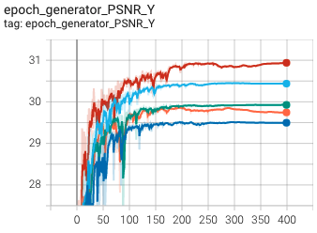
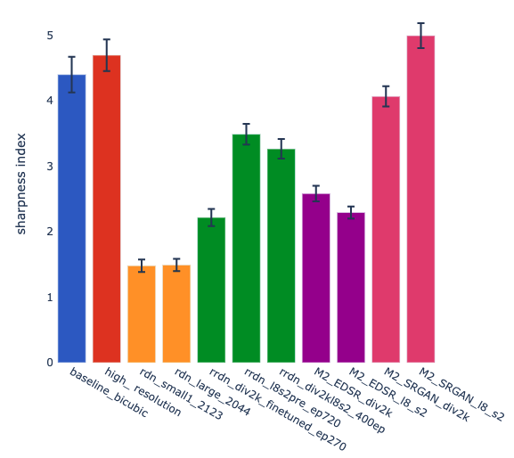
How did we get there?
2021-08
Data collection & pre-processing
Modelling &
fine tuning
Evaluation

Slide 13
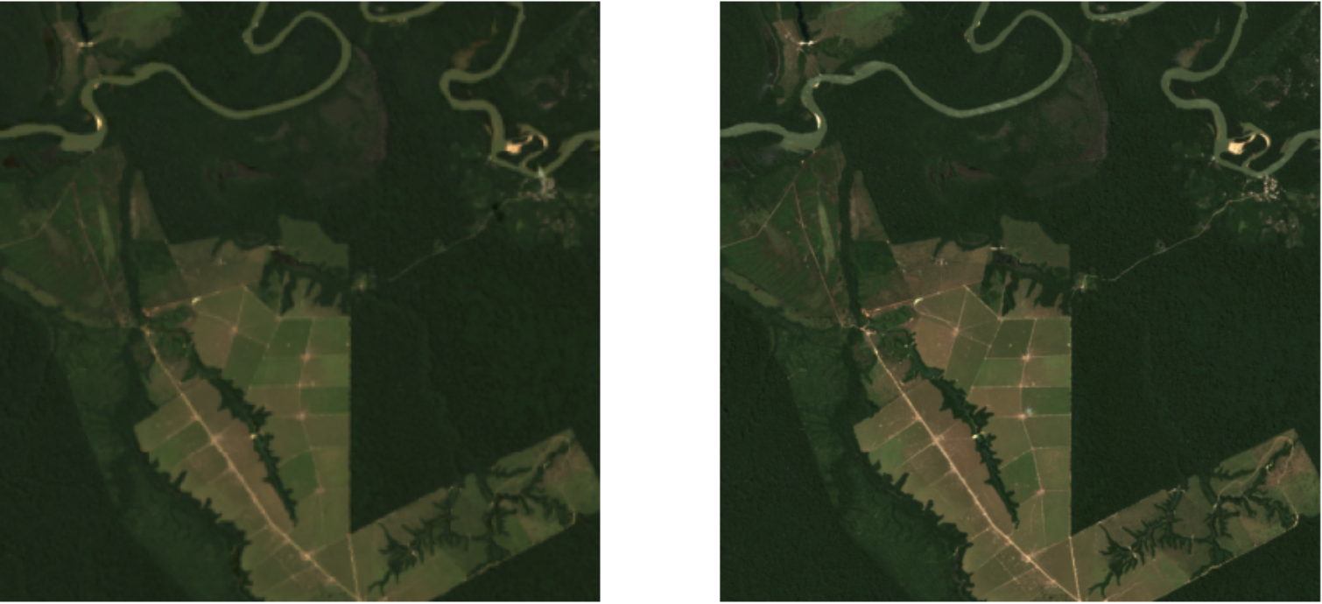
How did we get there?
2021-08
Data collection & pre-processing
Python API for
800 image pair dataset
Select a forested region (Brazil, Honduras, Madagascar… )
Apply temporal, cloud, and missing data filters to obtain quality image pairs
Standardize image (pixel scaling, resizing)

Slide 14
How did we get there?
2021-08
Data collection & pre-processing
Training
DIV2K dataset
landsat-sentinel dataset
Testing different models
RDN
RRDN
EDSR-SARGAN
Modelling &
fine tuning
Hyperparameter tuning
learning rates
image patch size
loss weighting for different network components

Slide 15
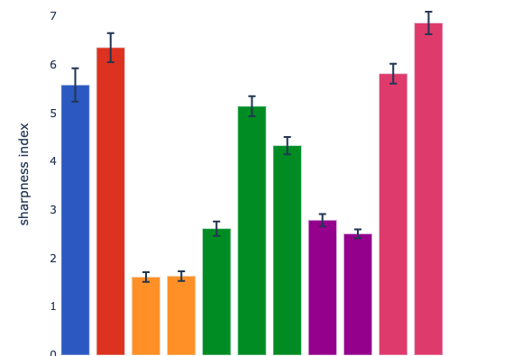
How did we get there?
2021-08
Assess performance:
gradient-based image sharpness index
Data collection & pre-processing
Modelling &
fine tuning
Evaluation
RRDN
EDSR
SRGAN
HIGH RES
RDN
BICUBIC

Slide 16
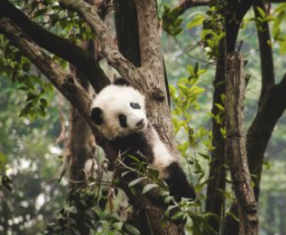
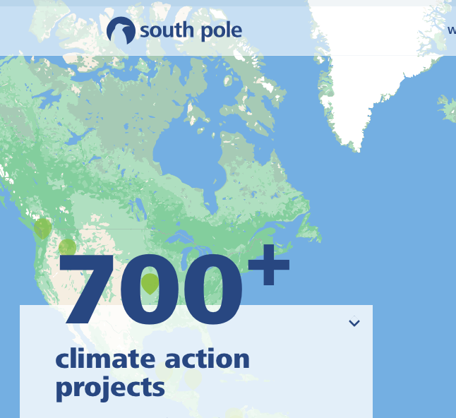

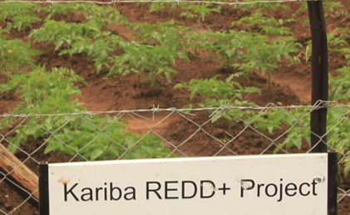
Conclusions & Outlook
Adversarial deep learning models (RRDN, SRGAN) show superior performance in upscaling low-resolution satellite images, but fine-tuning still needed
Next step: use the super-resolution images to assess impact of climate action projects
images adapted from SouthPole.com

Slide 17


Thank you!
Elena Gronskaya
Özgün Haznedar
elena . n . gronskaya @ gmail . com
in/elenagronskaya/
ozgunh @ gmail . com
in/ozgun-haznedar/

